Slide 1

A Project on Contact Management System
BANGLADESH UNIVERSITY OF BUSINESS
AND TECHNOLOGY-BUBT
Presented By:
Presented To:
Nur Md. Sohel
(ID:19202103358)
Md.Shafiul Alam
(ID:19202103327)
A.N.M. Liazur Rahman
(ID:19202103344)
Umme Hafcha Mukti
Course Instructor,
Department of Computer Science and Engineering
Bangladesh University of Business and Technology.

Slide 2
Outline of This Presentation:
Introduction
Objective
Project illustration
Requirements
Demonstration
Conclusion
Future work

Slide 3
1-Introduction:
A Contact Management System (most commonly know as a CRM or Customer Relationship Management) is a program that enables you to store and manage contact information. They are essentially databases that track all your information and communication based on your contacts.

Slide 4
2-Objective:
Improve data management system.
Improve customer satisfaction.
Improve the efficiency of business.
Increase productivity.
It saves time – once customers entered the information on each client, they have a quick and easy access to vital information.

Slide 5
3-Project illustration:
Add new contacts
Search contacts
List all contacts
Contact
Management
system
Edit contacts
Delete contacts

Slide 6
4-Requirements:
Hardware Requirements:
Processor : Intel core i3 2.12 GHz
RAM : 2 GB
Hard disk : 256 GB
Monitor : 15” color monitor
Keyboard : 104 keys
Software Requirements:
Operating System : Windows XP, Windows 7,8, Linux.
Language : C/C++
IDE : Code Blocks
Browser : Any of Mozilla, Opera, Chrome etc.

Slide 7
5-Demonstration:
#include<stdio.h>
#include<conio.h>
#include<string.h>
#include<process.h>
#include<stdlib.h>
#include<dos.h>
void login()
struct contact
{
long ph;
char name[20],add[20],email[30];
} list;
char query[20],name[20];
FILE *fp, *ft;
int i,n,ch,l,found;
int main()
{
main:
login();
time_t t;
time(&t);
system("cls");
/* ************ Main menu *********************** */
printf("\n\t **** Contact Management System ****");
printf("\n\n\n\t\t\tMAIN MENU\n\t\t\=====================\n\t\t[
[1] Add new Contact\n\t\t
[2] List all Contacts\n\t\t
[3] Search for Contact\n\t\t
[4] Edit a Contact\n\t\t
[5] Delete a Contact\n\t\t
[0] Exit\n\t\t\=================\n\t\t");
for(i=0;i<50;i++)
printf("-");
printf("\n\t\tCurrent date and time : %s",ctime(&t));
printf("\n\t\tEnter the Choice:");
scanf("%d",&ch);
switch(ch)
{
case 0:
printf("\n\n\t\tAre you sure you want to exit?");
break;

Slide 8
/* *******************search contacts********************** */
case 3:
system("cls");
do
{
found=0;
printf("\n\n\t..::CONTACT SEARCH\n\t==================\n\t..::Name of contact to search: ");
fflush(stdin);
scanf("%[^\n]",&query);
l=strlen(query);
fp=fopen("contact.dll","r");
system("cls");
printf("\n\n..::Search result for '%s' \n==========================================\n",query);
while(fread(&list,sizeof(list),1,fp)==1)
{
for(i=0; i<=l; i++)
name[i]=list.name[i];
name[l]='\0';
if(stricmp(name,query)==0)
{
printf("\n..::Name\t: %s\n..::Phone\t: %ld\n..::Address\t: %s\n..::Email\t: %s\n",list.name,list.ph,list.add,list.email);
found++;
if (found%4==0)
{
printf("..::Press any key to continue...");
getch();
}
}
}
if(found==0)
printf("\n..::No match found!");
else
printf("\n..::%d match(s) found!",found);
fclose(fp);
printf("\n ..::Try again?\n\n\t[1] Yes\t\t[0] No\n\t");
scanf("%d",&ch);
}
while(ch==1);
break;
/* *********************Add new contacts************ */
case 1:
system("cls");
fp=fopen("contact.dll","a");
for (;;)
{
fflush(stdin);
printf("To exit enter blank space in the name input\nName
(Use identical):");
scanf("%[^\n]",&list.name);
if(stricmp(list.name,"")==0 || stricmp(list.name," ")==0)
break;
fflush(stdin);
printf("Phone:");
scanf("%ld",&list.ph);
fflush(stdin);
printf("address:");
scanf("%[^\n]",&list.add);
fflush(stdin);
printf("email address:");
gets(list.email);
printf("\n");
fwrite(&list,sizeof(list),1,fp);
}
fclose(fp);
break;

Slide 9
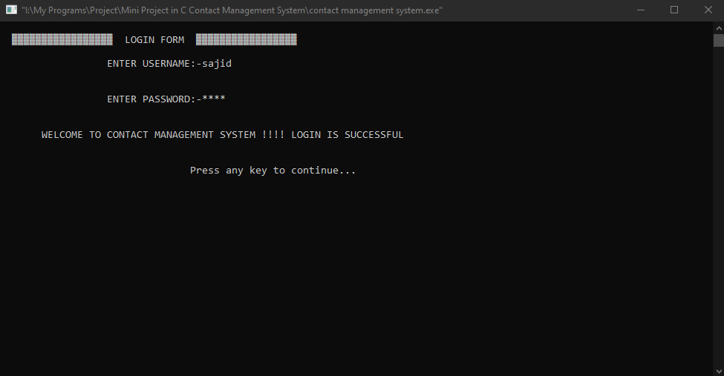
Login Screen:
The Console:

Slide 10
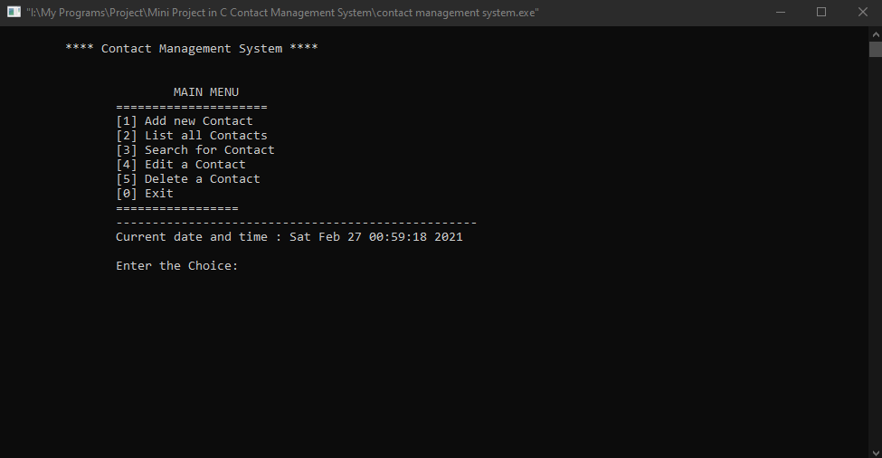
Main Menu:

Slide 11
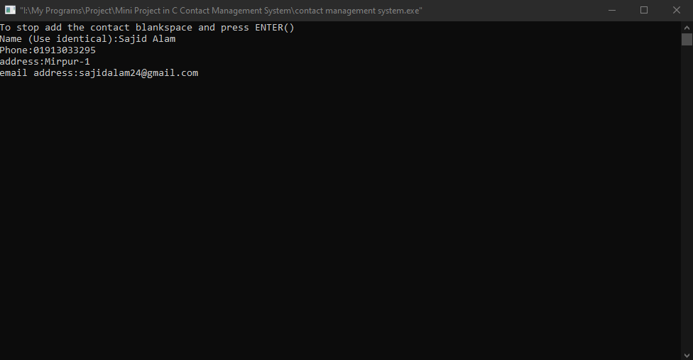
Add New Contacts:

Slide 12
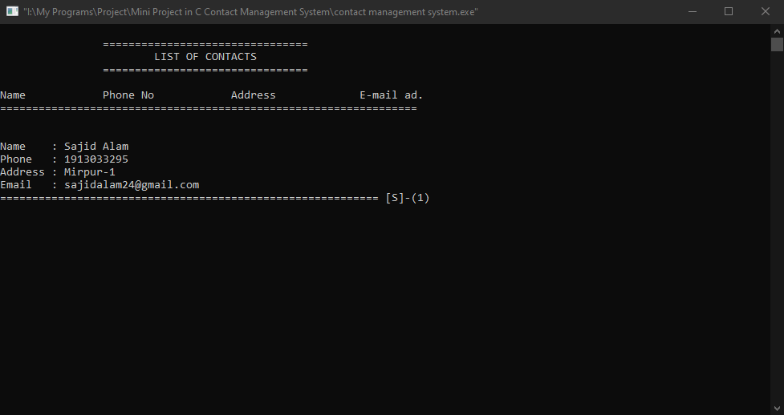
List All Contacts Details:

Slide 13
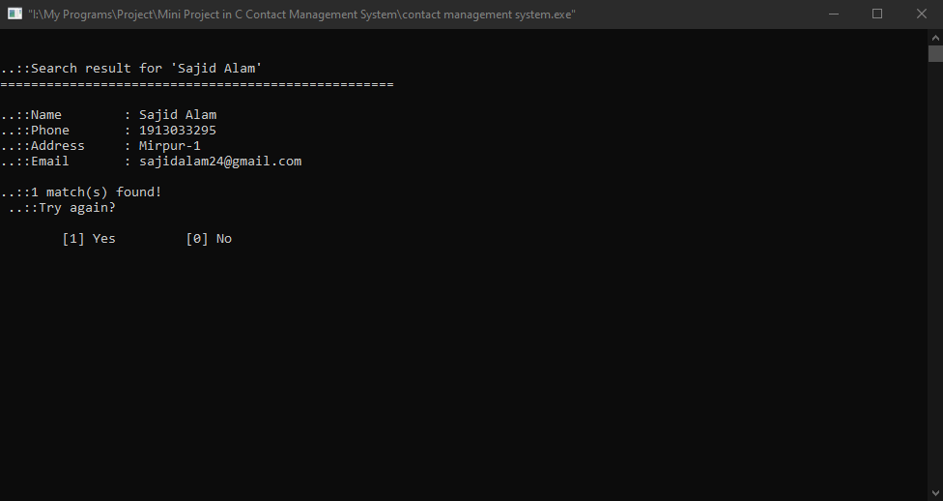
Search Contacts:

Slide 14
6-Conclusion :
We’ve discussed all the critical aspects of the contact management automated system. So far, whatever has been said, it should be taken into consideration that the success of any business, whether it is a large organization or a small startup solely relies on the level of satisfaction of the customer.

Slide 15
7-Future work:
We can give more advance software for Contact Management System including more facilities.
We can add printer in future.
We will host the platform on online servers to make it accessible worldwide.
Integrate multiple load balancers to distribute the loads of system.

Slide 16

Any Questions

Slide 17


